Slide 1
Venues Data Analysis of Moscow City

Slide 2
Determine the optimal places for the location of fitness centers in Moscow
Owners of cafes, fitness centers and other social facilities are expected to prefer boroughs with a high population density. Investors will prefer areas with low housing costs and low competitiveness.
On the part of residents, the preference is expected for a boroughs with a low cost of housing and good accessibility of social places.

Slide 3
Data acquisition and cleaning
Data for Moscow Boroughs dataset were downloaded from multiple HTTP page combined into one pandas dataframe.
List of Moscow District and they Boroughs were downloaded from the page Moscow Boroughs
Information about area of the each Moscow Borough in square kilometers, their population and housing area in square meters were downloaded from the page Moscow Boroughs Population Density
Information about housing price of the each Moscow Borough were downloaded from the page Moscow Boroughs Housing Price

Slide 4
Data acquisition and cleaning
To determine venues the service Forsquare API was used.
The API of Forsquare service have the restriction of 100 venues, which it can return in one request.
To obtain list of all venues I used the following approach:
present Moscow area in the form of a regular grid of circles of quite small diameter, no more than 100 venues in each circle
perform exploration using Forsquare API with quite bigger radius than circle of a grid to make sure it overlaps/full coverage to don't miss any venues
cleaning list of venues from duplicates.

Slide 5
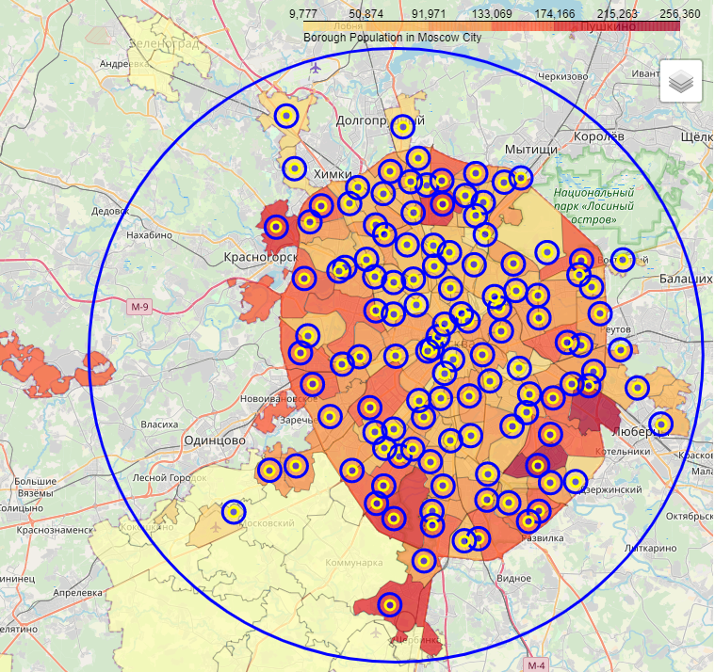
Boroughs population in Moscow City map

Slide 6
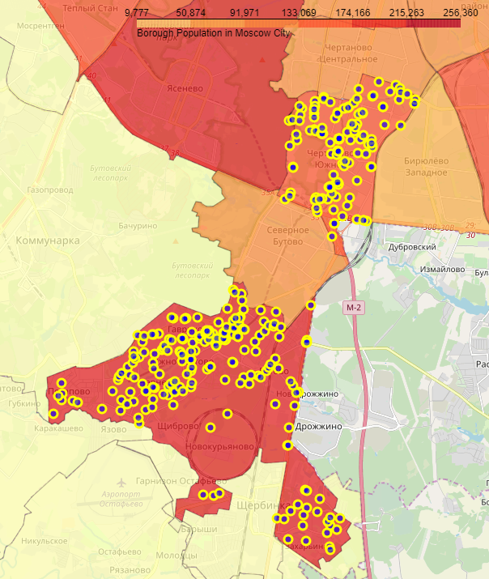
Some Moscow Boroughs and their venues

Slide 7
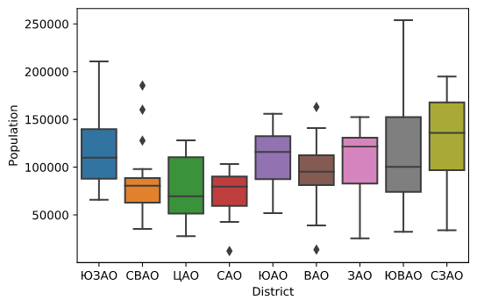
Distributions of Population between Boroughs in the different Districts

Slide 8
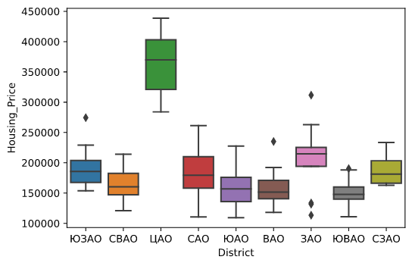
Distributions of House pricing between Boroughs in the different Districts

Slide 9
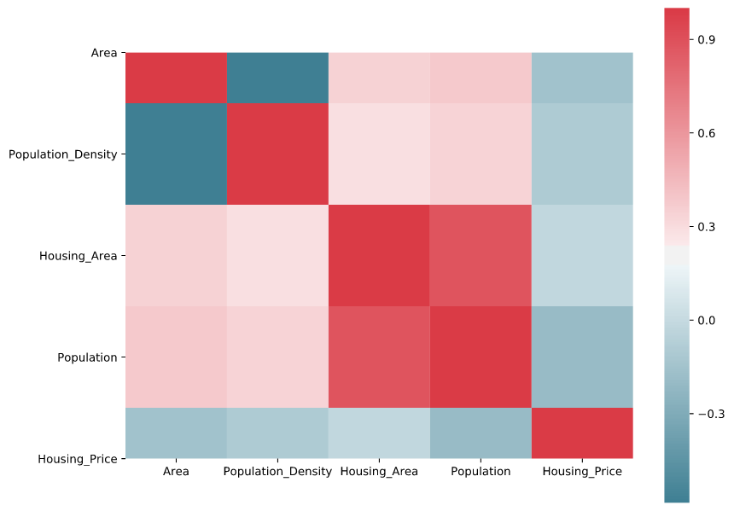
Correlation matrix

Slide 10
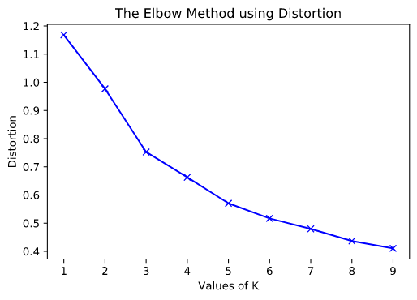
K-Means Clustering with elbow method

Slide 11
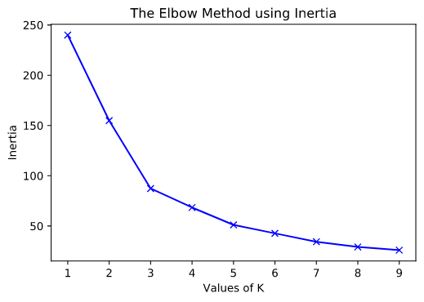
K-Means Clustering with elbow method

Slide 12
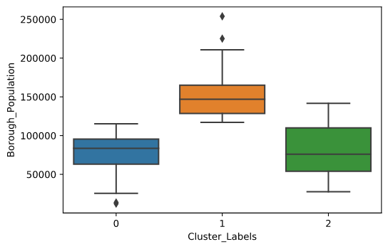
Clusters using boxplots visualization

Slide 13
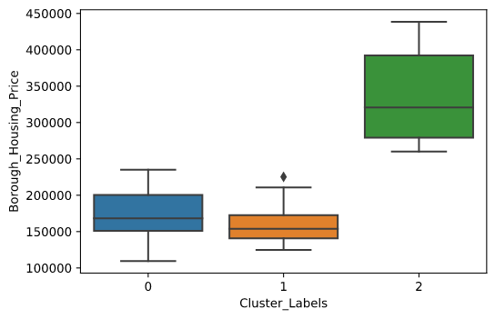
Clusters using boxplots visualization

Slide 14
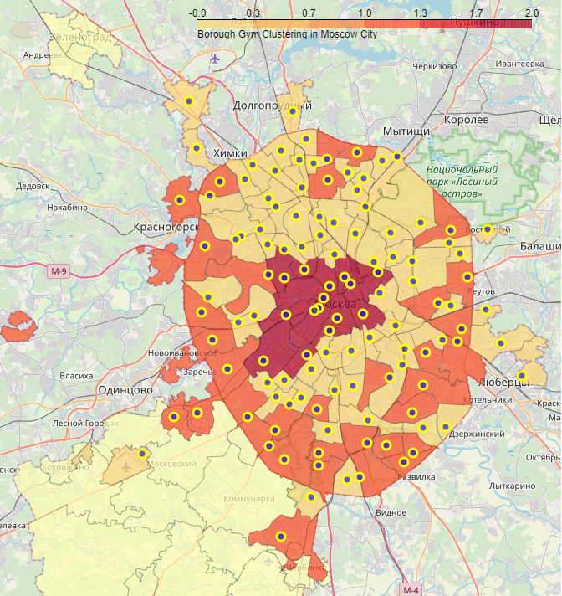
Vizualize clusters on choropleth map

Slide 15
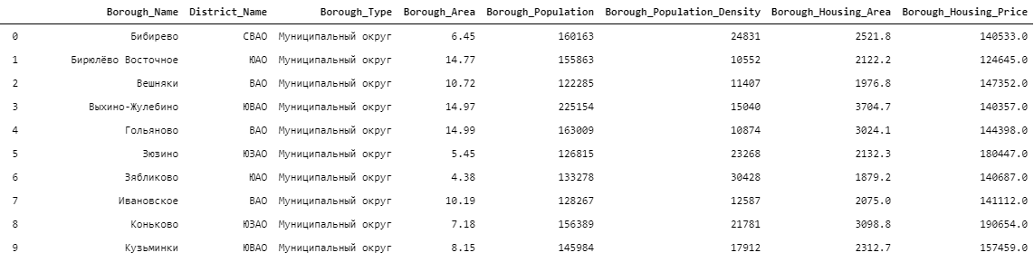
Result: Dataset of the optimal Boroughs
List of the optimal Boroughs for the location of fitness centers, according to the main criterias
high population of the borough
low cost of real estate in the borough

